Slide 1

Programming
Chapter 4
Variables, Data types and Operators
[Book name]

Slide 2
Variables
Variable
Data
Variable has:
Name: grade, age, salary
Type: integer, float, string
Data (value): 100, 10.5, “John”
Variable is used to store data
Notes:
Biến là gì?

Slide 3
Variables
Data
Variable
Data
Variable is used to store data
“Variable” means it could store different data at different time
Notes:
Biến là tên gọi cho một vùng nhớ(bên trong bộ nhớ máy tính chương trình khi chạy ) có khả năng chứa được một giá trị = một dữ liệu
Biến được khai báo và sử dụng để chứa dữ liệu của chương trình

Slide 4
Variables
Variables have name, data type and value
Assignment is done by the operator "="
Example of variable definition and assignment in C#
Variable name
Data type
int count = 5;
Variable value

Slide 5
Naming a Variable in C#
Variable names are case sensitive
nameVariable # NameVariable # Namevariable
Does not start with a number: 1x (False) x1 (True)
Does not contain special characters: Example: ~, !@,#,$ ,%,^,&,*,(,)
Do not name variables with keywords :
string, int, private ->illegal
Camel rule for variable naming: dateOfBirth, nameOfStudent
When declaring a variable, you should initialize it to a default value
Notes:
Chú ý đặt tên biến

Slide 6
What is a Data Type?
A data type:
Is a domain of values of similar characteristics
Defines the type of information stored in the computer memory (in a variable)
Examples:
Positive integers: 1, 2, 3, …
Alphabetical characters: a, b, c, …
Days of week: Monday, Tuesday, …
Notes:
Chú ý đặt tên biến

Slide 7
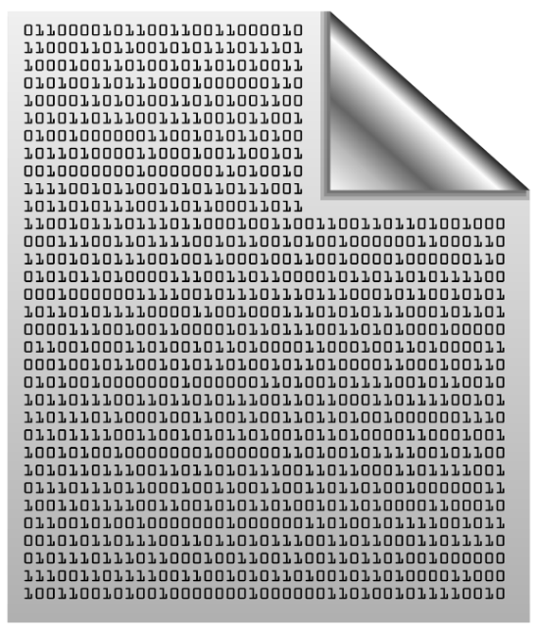
Data Type Characteristics
A data type has:
Name (C# keyword or .NET type)
Size (how much memory is used)
Default value
Example:
Integer numbers in C#
Name: int
Size: 32 bits (4 bytes)
Default value: 0
int: sequence of 32 bits in the memory
int: 4 sequential bytes in the memory

Slide 8
SOME COMMON DATA TYPES IN C#
Data Type | Size | Description
int | 4 bytes | Stores whole numbers from -2,147,483,648 to 2,147,483,647
long | 8 bytes | Stores whole numbers from -9,223,372,036,854,775,808 to 9,223,372,036,854,775,807
float | 4 bytes | Stores fractional numbers. Sufficient for storing 6 to 7 decimal digits
double | 8 bytes | Stores fractional numbers. Sufficient for storing 15 decimal digits
bool | 1 bit | Stores true or false values
char | 2 bytes | Stores a single character/letter, surrounded by single quotes
string | 2 bytes per character | Stores a sequence of characters, surrounded by double quotes
Notes:
Biến cần lưu lại -> cần kiểu dữ liệu để lưu cho phù hợp

Slide 9
Integer Types
Type | Default Value | Min Value | Max Value | Size
sbyte | 0 | -128 (-2⁷) | 127 (2⁷-1) | 8 bit
byte | 0 | 0 | 255 (2⁸-1) | 8 bit
short | 0 | -32768 (-2¹⁵) | 32767 (2¹⁵ - 1) | 16 bit
ushort | 0 | 0 | 65535 (2¹⁶-1) | 16 bit
int | 0 | -2147483648 (-2³¹) | 2147483647 (2³¹ – 1) | 32 bit
uint | 0 | 0 | 4294967295 (2³²-1) | 32 bit
long | 0 | -9223372036854775808 (-2⁶³) | 9223372036854775807 (2⁶³-1) | 64 bit
ulong | 0 | 0 | 18446744073709551615 (2⁶⁴-1) | 64 bit

Slide 10
Centuries – Example
Depending on the unit of measure we can use different data types:
byte centuries = 20;
ushort years = 2000;
uint days = 730484;
ulong hours = 17531616;
Console.WriteLine( "{0} centuries = {1} years = {2} days = {3} hours.", centuries, years, days, hours);
//20 centuries = 2000 years = 730484 days = 17531616 hours.

Slide 11
Beware of Integer Overflow!
Integers have range (minimal and maximal value)
Integers could overflow → this leads to incorrect values
byte counter = 0;
for (int i = 0; i < 260; i++)
{
counter++;
Console.WriteLine(counter);
}
1
2
…
255
0
1

Slide 12
What are Floating-Point Types?
Floating-point types:
Represent real numbers, e.g. 1.25, -0.38
Have range and precision depending on the memory used
Sometimes behave abnormally in the calculations
May hold very small and very big values like 0.00000000000001 and 10000000000000000000000000000000000.0

Slide 13
Floating-Point Numbers
Floating-point types are:
float (±1.5 × 10⁻⁴⁵ to ±3.4 × 10³⁸)
32-bits, precision of 7 digits
double (±5.0 × 10⁻³²⁴ to ±1.7 × 10³⁰⁸)
64-bits, precision of 15-16 digits
The default value of floating-point types:
Is 0.0F for the float type
Is 0.0D for the double type

Slide 14
PI Precision – Example
Difference in precision when using float and double:
NOTE: The "f" suffix in the first statement
Real numbers are by default interpreted as double
One should explicitly convert them to float
float floatPI = 3.141592653589793238f;
double doublePI = 3.141592653589793238;
Console.WriteLine("Float PI is: {0}", floatPI);
Console.WriteLine("Double PI is: {0}", doublePI);
3.141593
3.14159265358979

Slide 15
Decimal Floating-Point Type
There is a special decimal floating-point real number type in C#:
decimal (±1,0 × 10⁻²⁸ to ±7,9 × 10²⁸)
128-bits, precision of 28-29 digits
Used for financial calculations
Almost no round-off errors
Almost no loss of precision
The default value of decimal type is:
0.0M (M is the suffix for decimal numbers)

Slide 16
Problem: Exact Sum of Real Numbers
Write program to enter n numbers and print their exact sum:
2
1000000000000000000
5
1000000000000000005
2
0.00000000003
333333333333.3
333333333333.30000000003

Slide 17
Solution: Exact Sum of Real Numbers
This code works, but makes rounding mistakes sometimes:
Change double with decimal and check the differences
int n = int.Parse(Console.ReadLine());
double sum = 0;
for (int i = 0; i < n; i++)
sum += double.Parse(Console.ReadLine());
Console.WriteLine(sum);

Slide 18
Boolean Type
Boolean variables (bool) hold true or false:
int a = 1;
int b = 2;
bool greaterAB = (a > b);
Console.WriteLine(greaterAB); // False
bool equalA1 = (a == 1);
Console.WriteLine(equalA1); // True

Slide 19
The Character Data Type
The character data type in C#
Represents symbolic information
Is declared by the char keyword
Gives each symbol a corresponding integer code
Has a '\0' default value
Takes 16 bits of memory (from U+0000 to U+FFFF)
Holds a single Unicode character (or part of character)

Slide 20
Characters and Codes
Each character has an unique Unicode value (int):
char ch = 'a';
Console.WriteLine("The code of '{0}' is: {1}", ch, (int) ch);
ch = 'b';
Console.WriteLine("The code of '{0}' is: {1}", ch, (int) ch);
ch = 'A';
Console.WriteLine("The code of '{0}' is: {1}", ch, (int) ch);
ch = 'щ'; // Cyrillic letter 'sht'
Console.WriteLine("The code of '{0}' is: {1}", ch, (int) ch);

Slide 21
The String Data Type
The string data type in C#
Represents a sequence of characters
Is declared by the string keyword
Has a default value null (no value)
Strings are enclosed in quotes:
Strings can be concatenated
Using the + operator
string text = "Hello, C#";

Slide 22
Verbatim and Interpolated Strings
Strings are enclosed in quotes "":
Strings can be verbatim (no escaping):
You can use verbatim strings with interpolation:
The backslash \ is escaped by \\
string file = "C:\\Windows\\win.ini";
string file = @"C:\Windows\win.ini";
The backslash \ is not escaped
string os = "Windows";
string file = "win.ini";
string path = $@"C:\{os}\{file}";

Slide 23
Type casting in C#
During the calculation process, sometimes the returned data type is no longer the same as the original data type, so we need to cast it
In C#, there are two types of casting:
Implicit Casting (automatically) - converting a smaller type to a larger type size char -> int -> long -> float -> double (No loss data)
Explicit Casting (manually) - converting a larger type to a smaller size type double -> float -> long -> int -> char (lost data)
Notes:
Ép kiểu rộng: chuyển từ kiểu có vùng lưu trữ nhỏ lên kiểu có vùng lưu trữ lớn (ko sợ mất dữ liệu)
Ép kiểu hẹp: ngược lại (có thể mất dữ liệu)

Slide 24
Constants/Literals
Constants refer to fixed values
These fixed values are also called literals
E.g.,
Integer constants: 1, 2, 3,…
Floating constants: 1.1, 2.3, 4.0,...
Character constants: ‘a’, ‘b’, ‘c’,…
String literals: “Hello, there”, “Hi, there”, ...
Variables are used to hold constant values
But at different time it can hold different constant values
Notes:
Hằng số: nên khai báo in hoa

Slide 25
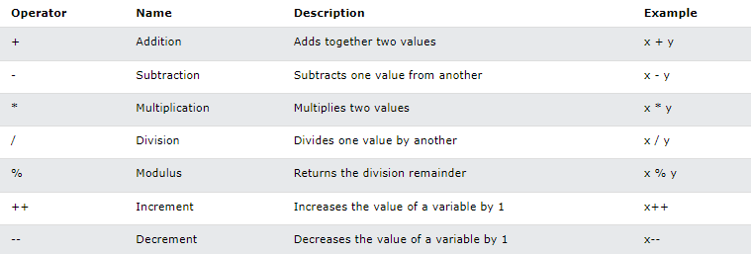
C# Operator
Operators are used to perform operations on variables and values
Arithmetic Operators

Slide 26
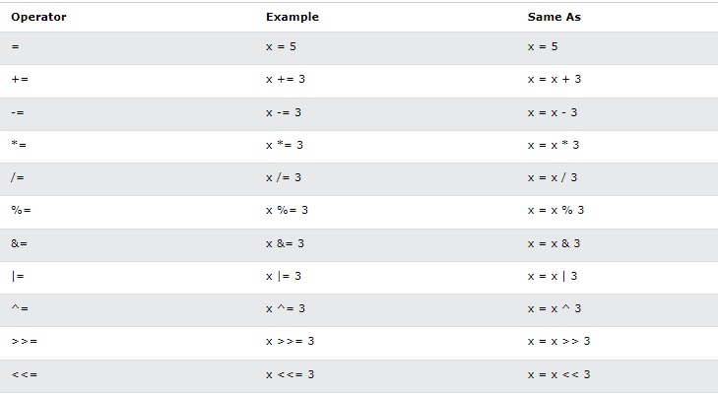
C# Operator
Assignment Operators
Notes:
Dạy kỹ phần toán tử

Slide 27
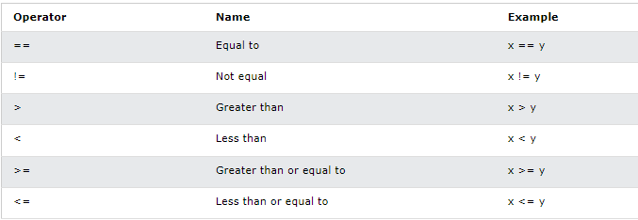
C# Operator
Comparison Operators

Slide 28
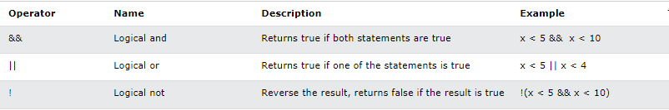
C# Operator
Logical Operators

Slide 29
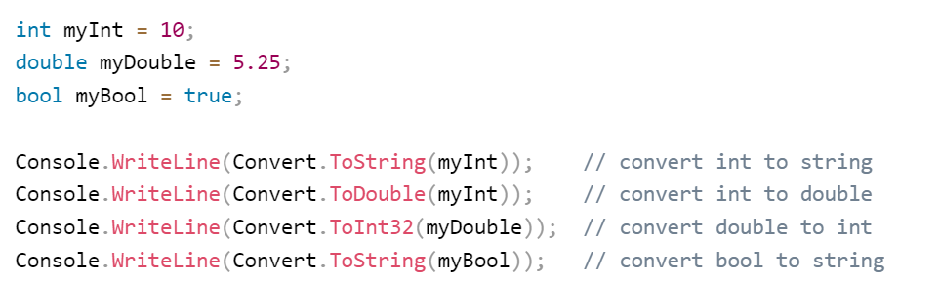
Type Conversion Methods
It is also possible to convert data types explicitly by using built-in methods,

Slide 30
Summary
…
…
…
Variables – store data
Numeral types:
Represent numbers
Have specific ranges for every type
String and text types:
Represent text
Sequences of Unicode characters
Type conversion: implicit and explicit

